Slide 1
Big Data, A.I. and Investing
Ken Liu

Slide 2
Artificial Intelligence & Predictive Analytics
Introduction to AI
Machine Learning
Open Discussion on the social impact of AI and the data privacy issue
Historical Data Analysis
Case Studies in in Trading

Slide 3
Introduction to AI - First AI Boom
The first AI boom came in the late 1950s.
Search program was based on fixed rules dividing cases.
Write out every possible pattern as machine can calculate much faster than a human can.
A machine will keep searching a million times and eventually will find the best answer.
The most popular search methods were depth-first search (DFS) and breadth-first search (BFS).

Slide 4
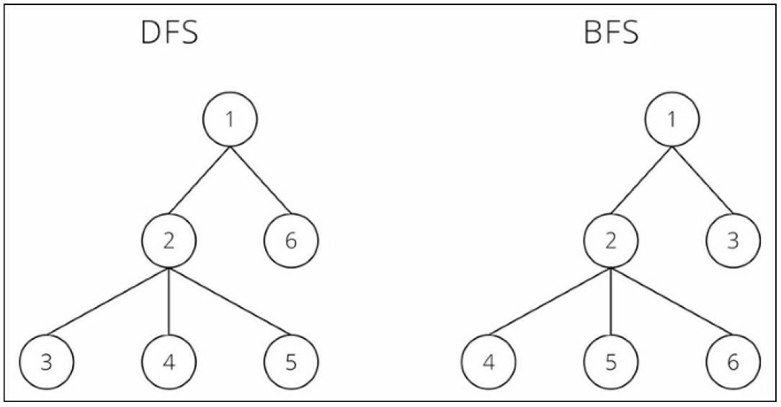
Introduction to AI - First AI Boom
Depth-First Search vs Breadth-First Search

Slide 5
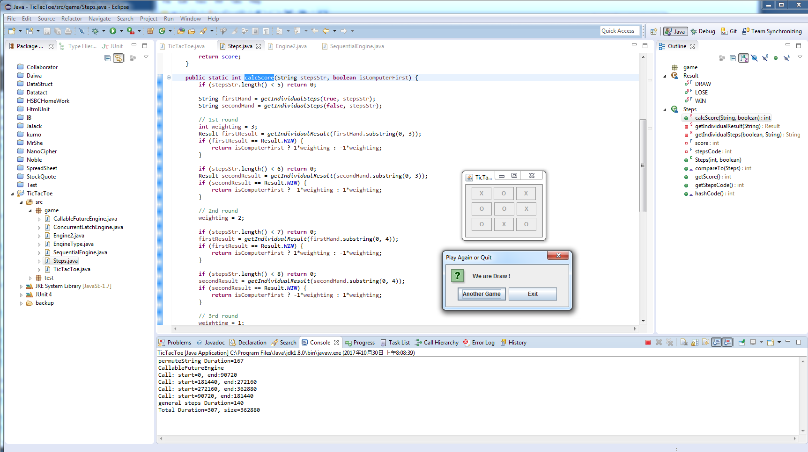
Introduction to AI - First AI Boom
Tick Tac Toe Example

Slide 6
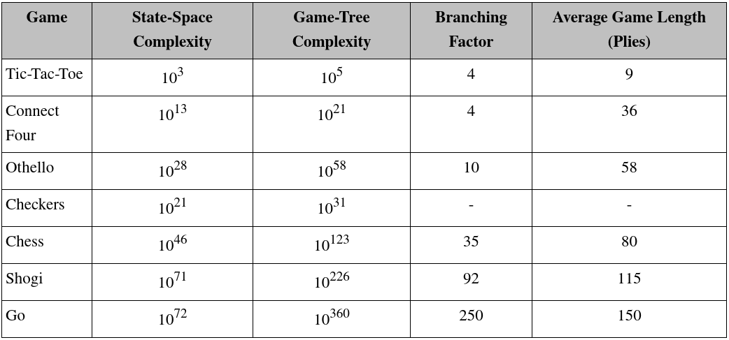
Introduction to AI - First AI Boom

Slide 7
Introduction to AI – First AI Boom
Search Optimization
Minimax
https://www.youtube.com/watch?v=KU9Ch59-4vw
Alpha–beta pruning
https://www.youtube.com/watch?v=xBXHtz4Gbdo
Key Points: State-Space (Complete Information and deterministic), Search Tree (Brute-force, Heuristic, Adversarial), Goal (Score, Weighting)

Slide 8
Introduction to AI – First AI Boom
Frame Problem
A machine can achieve great success in the field of Chess because the searching space is limited (set in a certain frame) in advance
Machine follow detailed rules set by a human. It is far from achieving actual AI. Therefore, the first AI boom cooled down rapidly with disappointment.
1997 News – IBM Deep Blue beats World Chess Champion Garry Kasparov
https://en.wikipedia.org/wiki/Deep_Blue_versus_Garry_Kasparov

Slide 9
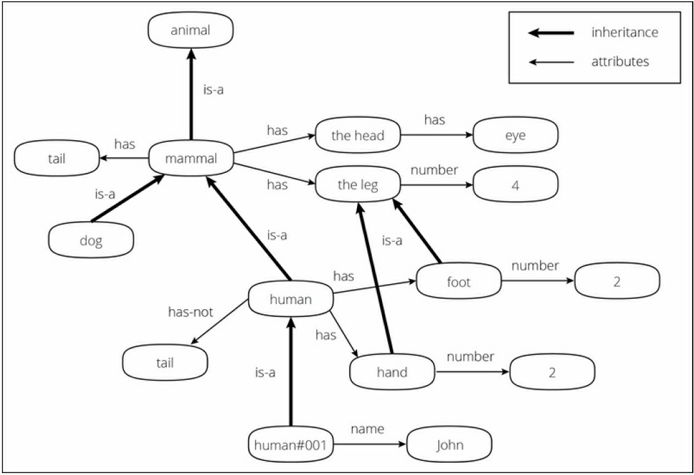
Introduction to AI – Second AI Boom
The second AI boom came in the 1980s.
Knowledge Representation (KR) and Expert system was booming and intended to describe knowledge that a machine could easily understand

Slide 10
Introduction to AI - Second AI Boom
Problems and Limitations
Inputting all real-world knowledge requires an almost infinite amount of work (Back then, Internet and Web were not existed yet)
Machine does not understands the actual meaning of the knowledge. Even if the knowledge is structured and systemized, a machine understands it as a mark and never understands the concept. Machine just compare the data and assume meaning based on the dictionary.
For example, if you know the concept of "apple" and "green" and are taught "green apple = apple + green", then you can understand that "a green apple is a green colored apple" at first sight, whereas a machine can't. This is called the symbol grounding problem and is considered one of the biggest problems in the AI field, as well as the frame problem.

Slide 11
Introduction to AI - Second AI Boom
Today the Internet is more commonly used and we can obtain enormous amounts of open data from the Web.
This work of representing all the world's data has continued and is known as Cyc (http://www.cyc.com). Cyc's ultimate purpose is to build an inference engine based on the database of this knowledge, called knowledge base.
(Has Google search become Expert System in itself?)

Slide 12
Introduction to AI – Approaches
Symbolic: explore the possibility that human intelligence could be reduced to symbol manipulation (Human express knowledge in language which is symbols)
Cognitive simulation: defining heuristic algorithms in order to simulate human cognitive abilities, e.g., reasoning, problem solving, object recognition, and learning. We try to discover elementary concepts and rules which are used by a human being for solving generic problems.
Logic base: machines did not need to simulate human thought, but should instead try to find the essence of abstract reasoning and problem solving, regardless of whether people used the same algorithms (e.g. LISP programming language encode the logic)

Slide 13
Introduction to AI – Approaches
Evolutionary: a form of optimization search. They may begin with a population of organisms (the guesses) and then allow them to mutate and recombine, selecting only the fittest to survive each generation (refining the guesses). Examples are genetic programming, ant colony or particle swam optimization.
Connectionist: the learning is a result of associations between stimuli and responses to stimuli. Associations become strengthened if an organism is trained with stimulus-response exercises, and they become weakened if such training is discontinued (bio-inspired model and the best example is Neural Network)
Computational and Statistical: learning from the experience (data) and derive the statistical meaning of inference from the data (Machine Learning).

Slide 14
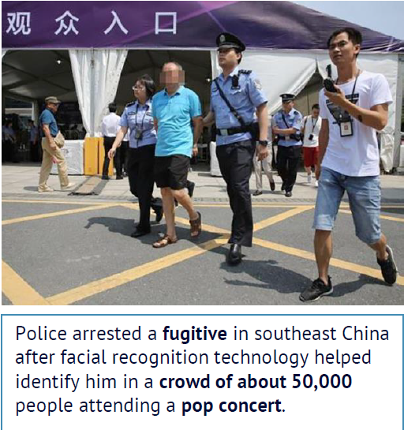
Introduction to AI - Third AI Boom (Now)
Machine Learning: a branch of AI and the key driver is (big) data from Internet, Mobile and IoT (Internet of Things which are sensors, smart devices etc.)
Example: 1.3 billions of faces in China, how can tell a computer to recognize a person?
# pseudo code
Color in {brown, yellow, black}
Has {hair, eye * 2, nose, mouth,
ear * 2 ……}
Eye: {black, white, brown ……..}
……………….
https://www.npr.org/sections/therecord/2018/05/23/613692526/thanks-to-ai-a-3rd-person-is-arrested-following-a-pop-superstars-concert

Slide 15
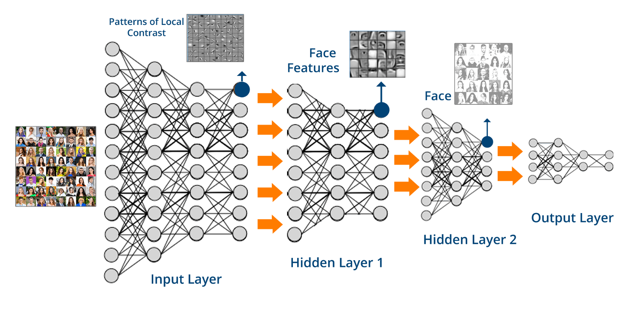
Introduction to AI - Third AI Boom (Now)
Learn from data rather than explicitly program the logic: let the computer see many examples (face, name) and learn how to represent it in a Deep Neural Network (brain-like structure)

Slide 16
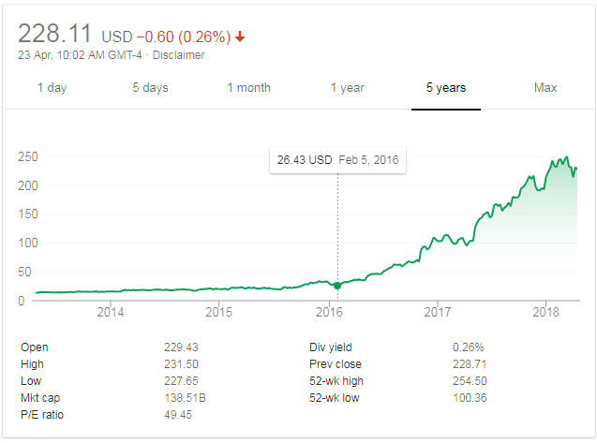
Introduction to AI - Third AI Boom (Now)
Other Main Drivers
Commodities Infra (Cloud) : rent super computers (from AWS, Google Cloud etc.) for few hours to train the machine learning model. (Training vs Predicting time)
Hardware Parallelization: GPU (Graphics Processing Unit) substantially improve the speed of calculation (nVidia stock price has gone up substantially)
One more usage: https://easyhashing.com/en/
Notes:
Long nVidia is better than so many quant trades !

Slide 17
Introduction to AI - Third AI Boom (Now)
Algorithms: new techniques in processing data in parallel. Such as Map-Reduce which distribute the program logic to the data and combine the results.
Breakthrough: Deep Learning solve some bottlenecks previously encountered in Neural Networks and results in commercial success.
2013 Playing Atari with Deep Reinforcement Learning
https://arxiv.org/abs/1312.5602
2016 AlphaGo
https://www.theverge.com/2017/5/25/15689462/alphago-ke-jie-game-2-result-google-deepmind-china

Slide 18
Introduction to AI - Third AI Boom (Now)
Community and Competition: Open Source APIs and prize awards
Kaggle Competitions: https://www.kaggle.com/competitions
Netflix Prize: https://en.wikipedia.org/wiki/Netflix_Prize
https://www.netflixprize.com/leaderboard.html
(open competition for the best collaborative filtering algorithm to predict user ratings for films, based on previous ratings without any other information about the users or films, i.e. without the users or the films being identified except by numbers assigned for the contest. On September 21, 2009, the grand prize of US$1,000,000 was given to the BellKor's Pragmatic Chaos team which bested Netflix's own algorithm for predicting ratings by 10.06%.)
IBM’s Watson Analytics platform is now open to everyone: https://thenextweb.com/apps/2014/12/04/ibms-watson-powered-analytics-platform-now-open-everyone/

Slide 19

Machine Learning – Use Cases
Pattern recognition: Face (iPhoneX FaceId), OCR (Handwriting)
http://www.telegraph.co.uk/news/2017/03/20/beijing-park-uses-face-recognition-software-wipe-toilet-paper/
https://www.techjuice.pk/this-school-scans-classrooms-every-30-seconds-through-facial-recognition-technology
https://qz.com/1356503/how-to-dodge-wechats-image-censorship-according-to-citizen-lab/
If you can still unlock FaceId, it’s called make-up, otherwise it’s a “fake-up”
卸咗妝後 FaceId 仲認得叫做化妝，認唔到嘅叫做喬裝)

Slide 20
Machine Learning – Use Cases
Computer Vision: Autonomous driving
http://www.scmp.com/news/hong-kong/community/article/2132892/hong-kong-bus-crash-survivor-describes-horror-accident
Level 0: The driver controls it all
Level 1: Most functions are still controlled by the driver, but a specific function (like steering or accelerating) can be done automatically by the car.
Level 2: At least one driver assistance system is automated, like cruise control and lane-centering. It means that the "driver is disengaged from physically operating the vehicle by off the steering wheel AND foot off pedal at the same time“. The driver must still always be ready to take control of the vehicle, however.

Slide 21
Machine Learning - Use Cases
Level 3: Shift "safety-critical functions" to the vehicle, under certain traffic or environmental conditions. It means that the driver is still present and will intervene if necessary, but is not required to monitor the situation likes previous levels.
Level 4: vehicles are "designed to perform all safety-critical driving functions and monitor roadway conditions for an entire trip.“ (fully autonomous) However, it's important to note that this is limited to the "operational design domain (ODD)" of the vehicle—meaning it does not cover every driving scenario.
Level 5: vehicle's performance to equal that of a human driver, in every driving scenario including extreme environments like dirt roads that are unlikely to be navigated by driverless vehicles in the near future.
(Side bar: law of driving, insurance, Algo ethical?
http://fortune.com/2016/10/15/mercedes-self-driving-car-ethics/
http://www.businessinsider.com/self-driving-cars-already-deciding-who-to-kill-2016-12)

Slide 22
Machine Learning - Use Cases
Classification: Spam filtering
http://fortune.com/2017/06/29/instagram-artificial-intelligence-offensive-comments/
Anomaly Detection: Credit card frauds
https://www.prnewswire.com/news-releases/fico-machine-learning-algorithms-improve-card-not-present-fraud-detection-by-30-300529629.html
Recommendation: Predict customer behaviors
https://www.mediapost.com/publications/article/308948/amazon-patent-hangs-advertising-on-real-time-updat.html

Slide 23
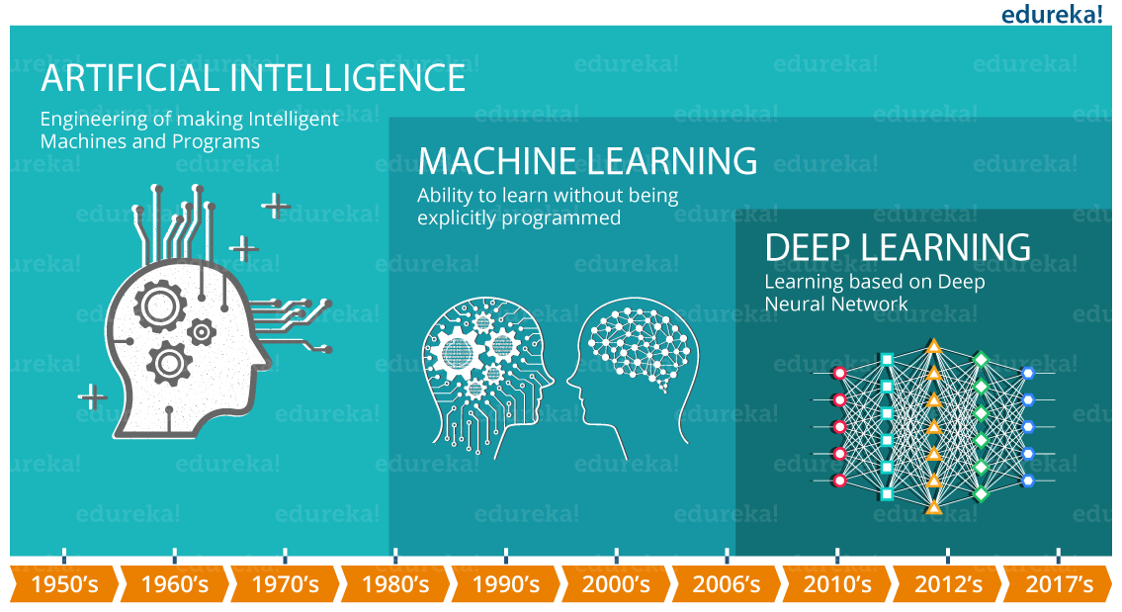
Machine Learning in Context

Slide 24
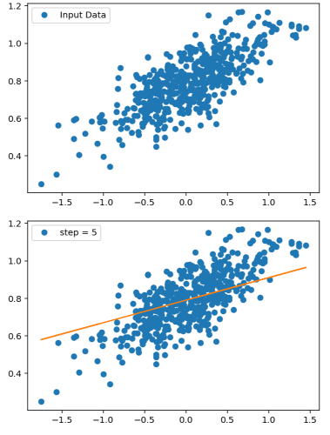
Example – Linear Regression
Learning Regression (the model)
y = ax + b
Input Data -> Output
Parameter (a, b)
Loss/Objective fuction
Gradient Descent
Training (no. of steps)

Slide 25
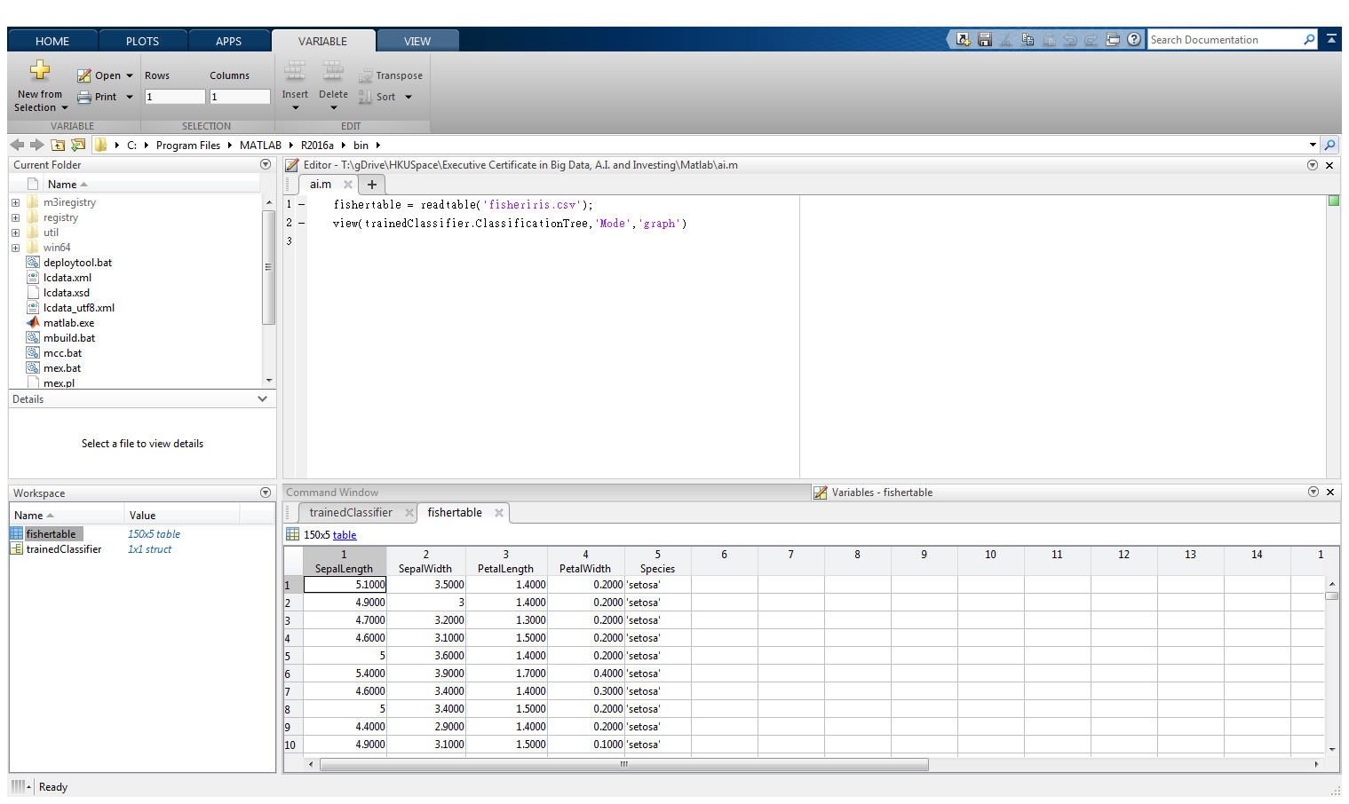
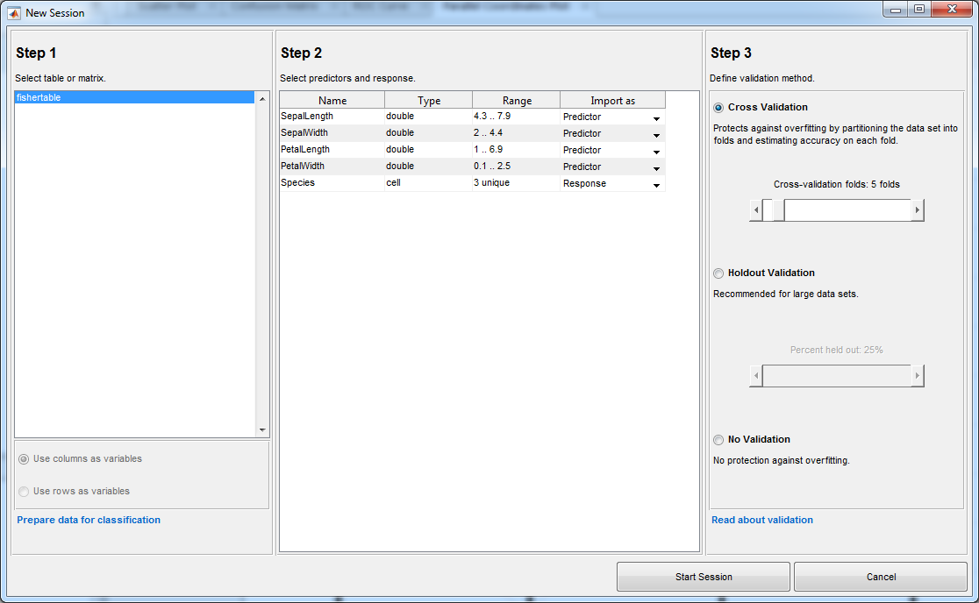
Demo - Decision Tree

Slide 26
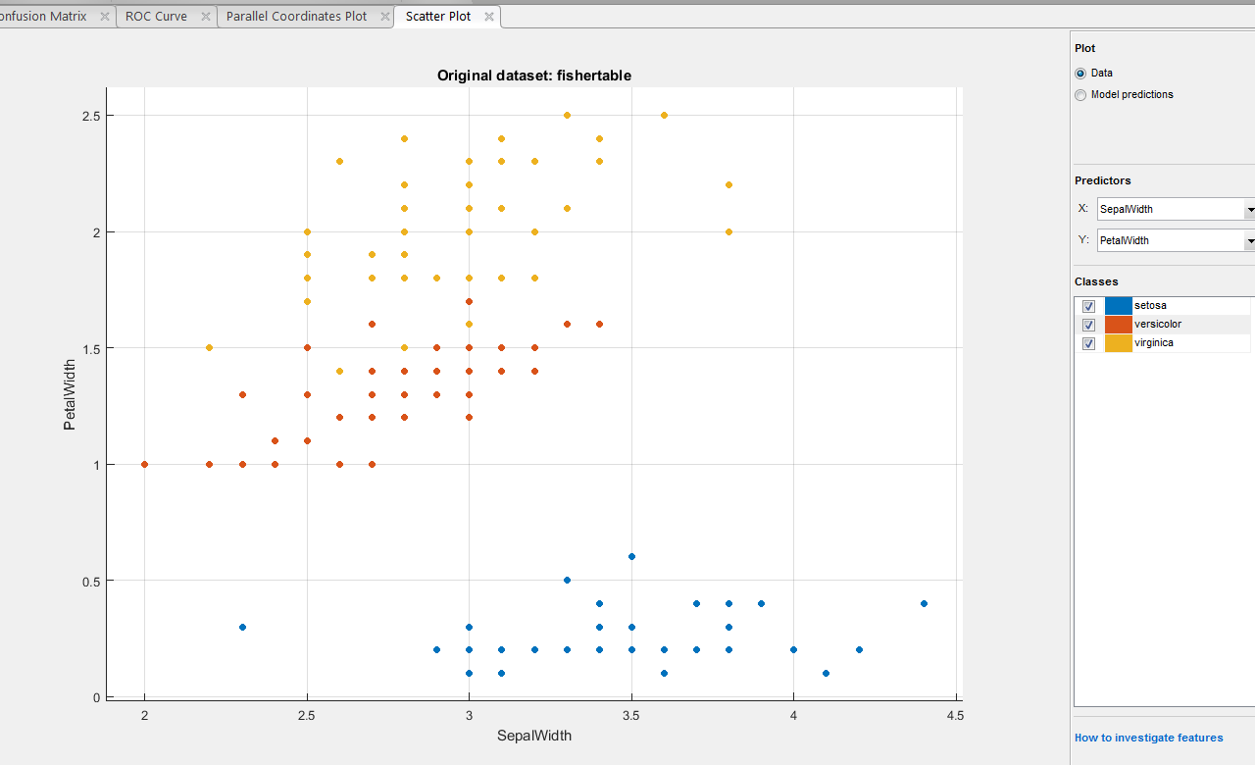
Demo – Decision Tree

Slide 27
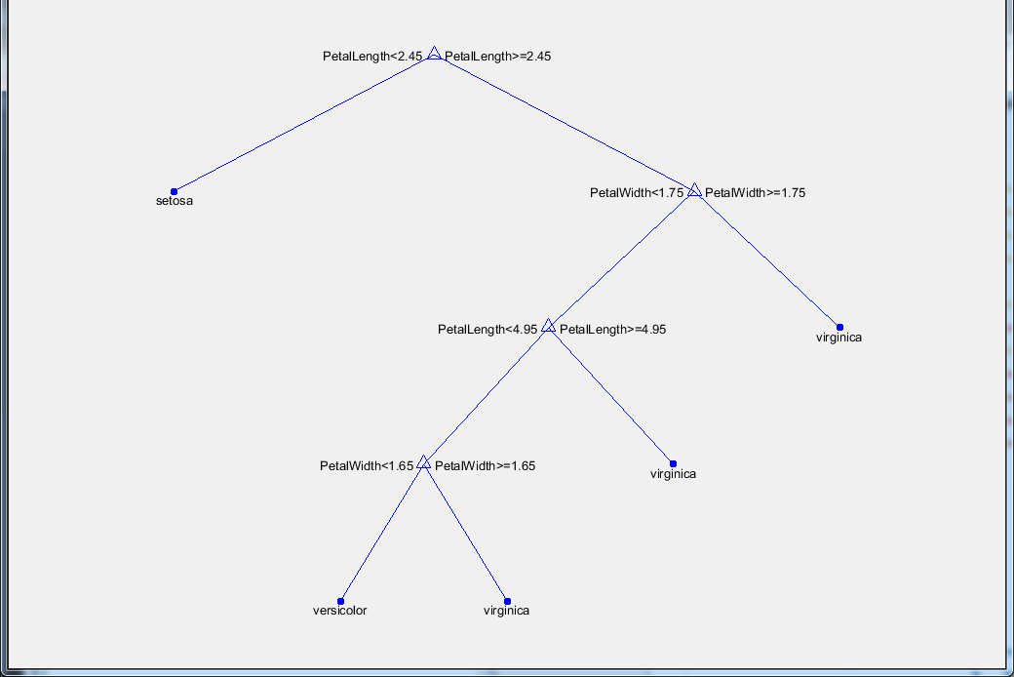
Demo – Decision Tree

Slide 28
Machine Learning - Basics
Dataset + Learning Algorithm + Objective Function + Model
Learning: ^E(Experience) -> ^(P(Performance) of T(Task))
Experience: Dataset (features)
Task: {Classification, Regression, Clustering,, Translation, Anomaly detection....}
Performance: {Test Data, Training Data, Validation Data}

Slide 29
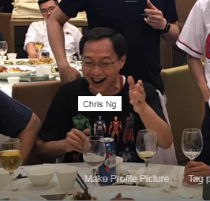
Machine Learning - Basics
Supervised Learning: presented with example inputs and their desired outputs, given by a "teacher“. The goal is to learn a general rule that maps inputs to outputs (i.e. learn a function of g(x) = y)
The dataset commonly know as feature vectors (e.g. sepal length, sepal width)
It requires large human efforts to manually labelled the data. Nonetheless, the internet already provide many source of labelled data: movies reviews, subtitles, tag your friend in photos, social media reactions
Where to find labelled dataset?
https://www.kaggle.com/datasets
Human Data Labeler
You ! (e.g. tagged your friend in Facebook)

Slide 30
Machine Learning - Basics
Un-Supervised Learning: discover hidden structure (like clustering) or correlation from unlabeled data
Semi-supervised learning: falls between unsupervised learning (without any labeled training data) and supervised learning (with completely labeled training data). The acquisition of labeled data for a learning problem often requires a skilled human agent or a physical experiment. The cost associated with the labeling process thus may render a fully labeled training set infeasible, whereas acquisition of unlabeled data is relatively inexpensive.
Reinforcement Learning: interacts with a dynamic environment in which it must perform a certain goal (such as playing a game against an opponent). The program is provided feedback in terms of rewards and punishments as it navigates its problem space.

Slide 31
Machine Learning - Basics
Classification: predict a discrete number of values
Binary Classification : when there is only two classes to predict, usually 1 or 0; True or False.
Multi-Class Classification: when there are more than two class labels to predict we call multi-classification task. e.g. predicting 3 types of iris species; image classification problems where there are more than thousands classes(cat, dog, fish, car,…).
Regression: predict continuous valued output. For example, given a size of the house predict the price (real value).

Slide 32
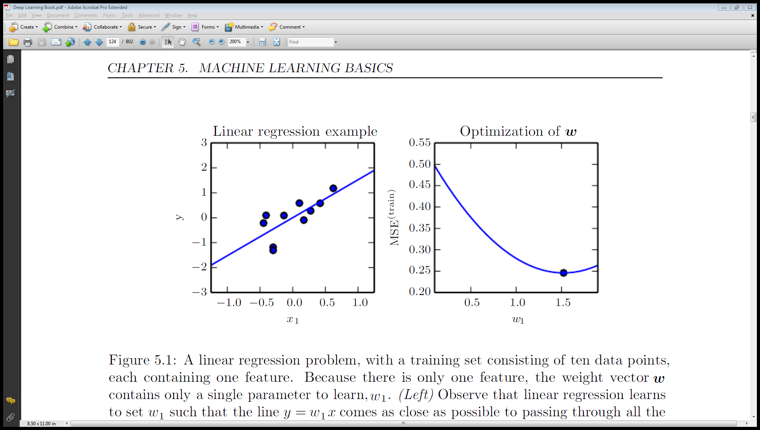
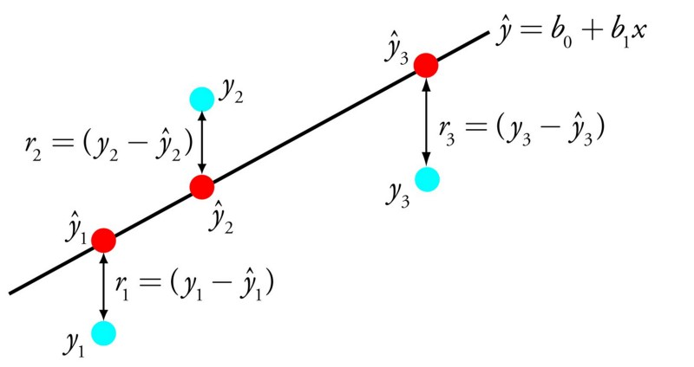
Machine Learning - Objective function
Objective function: a way to measuring the quality the model. This function, taking data and model parameters as arguments, can be evaluated to return a number. Any given problem contains some parameters which can be changed; our goal is to find values for these parameters which either maximize or minimize this number. (Similar terms: Cost function, Loss Function)

Slide 33

Machine Learning - Gradient Descent
Gradient Descent: an optimization algorithm used to find the values of parameters (coefficients) of a function (f) that minimizes a cost function (cost).
Notes: Hyper-parameters are parameters whose values are set prior to the commencement of the learning process. By contrast, the values of other parameters are derived via training.

Slide 34
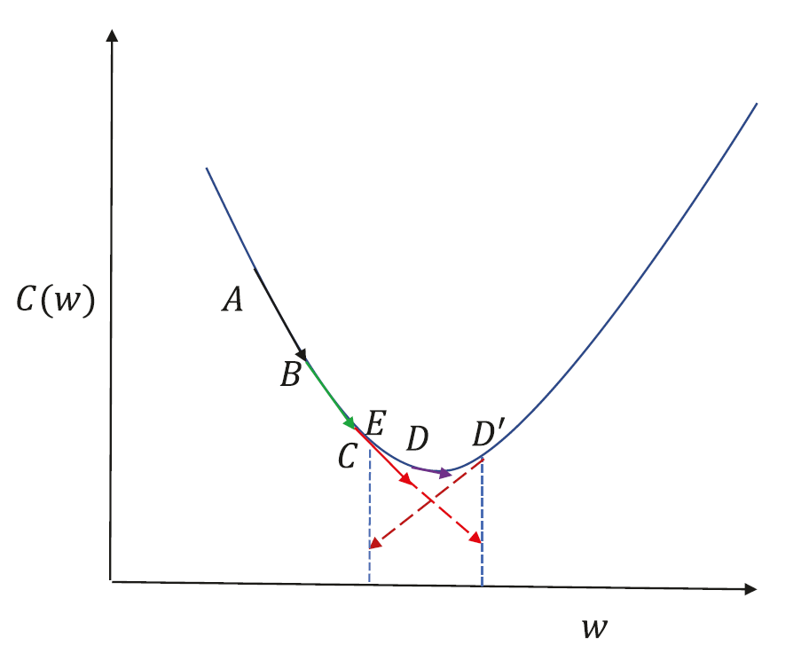
Machine Learning – Learning Rate
Cost function between A and C is almost linear, and so gradient descent works well.
From point C, if we take a small learning rate at C, we will end up at D, which is reasonable enough since it doesn’t overshoot the point of minima.
A larger step size at C will get us to D ', which is not desirable, because it’s on the other side of the minima.
A large step size at D ' would get us to E, and if the learning rate is not reduced the algorithm tends to toggle between points on either side of the minima, leading to oscillations

Slide 35
Machine Learning – Data Set
In-Sample: the data set used in the model training
Training Set: the labelled data used to train the underlying model during learning
Validation Set: a set of examples used to tune the parameters of a classifier
Cross Validation: select a number of folds to partition the data set. For each fold, trains a model using the out-of-fold observations. Assesses model performance using in-fold data and calculates the average test error over all folds. This method gives a good estimate of the predictive accuracy of the final model trained with all the data. It requires multiple fits but makes efficient use of all the data, so it is recommended for small data sets.
Holdout Validation: reserve certain % of the training data as test set. Train the model on the training set and assesses the performance with the test set. The resulting model is based on only a portion of the data, so it is recommended only for large data sets.
Out-Sample: the data set not seen by the model
Test Set: a set of examples used only to assess the performance of a fully-trained classifier

Slide 36
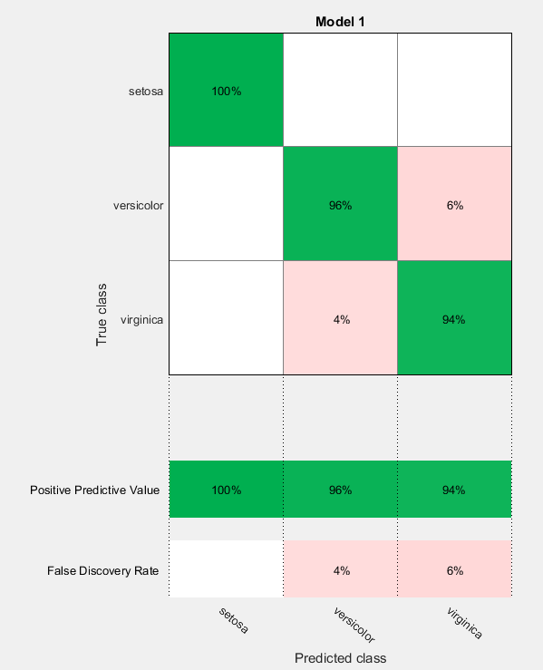
Machine Learning - Confusion Matrix
False Positive: a result that indicates a given condition exists, when it does not. A false positive error is a type I error where the test is checking a single condition, and wrongly gives an affirmative (positive) decision.
False Negative: a result that indicates that a condition does not hold, while in fact it does. A false negative error is a type II error occurring in a test where a single condition is checked for and the result of the test is erroneously that the condition is absent.
(Discussion: Production Support, Laws)

Slide 37
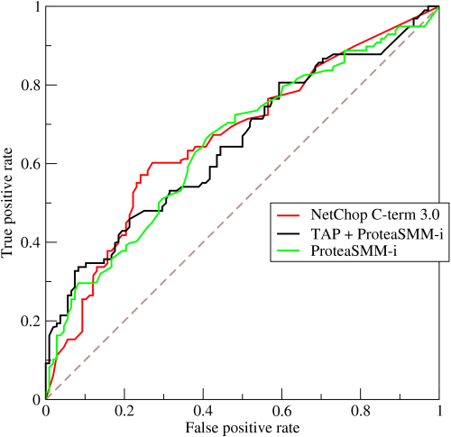
Machine Learning - ROC curve
Receiver Operating Characteristic (ROC) curve: plots the true positive rate against the false positive rate at various threshold settings. The true-positive rate is also known as sensitivity, recall or probability of detection in machine learning. The false-positive rate is also known as the fall-out or probability of false alarm and can be calculated as (1 − specificity). The ROC curve is thus the sensitivity as a function of fall-out.

Slide 38
Machine Learning - Workflow
Pre-process: determine the input for the machine learning model
Dataset: Collect, Clean and Normalize (e.g. scale the data into standard measure) the data
EDA (Exploratory Data Analysis): Visualize (e.g. scatter plot) the data to understand the key properties
Feature Selections: apply dimension reduction techniques (e.g. Principle Component Analysis or Factor Analysis) to see if the data (i.e. input features) can be reduced while maintain the similar predictive power.
(Note: Data collection and feature selection usually required in-depth domain knowledge to pick up the right dataset for training)

Slide 39
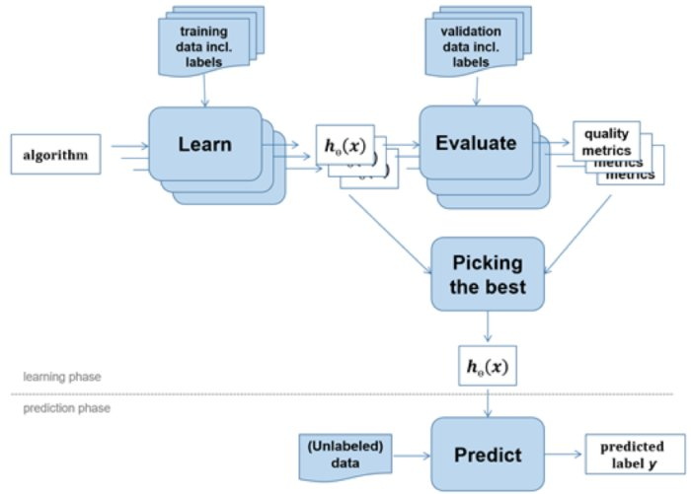
Machine Learning - Workflow
Training and Prediction
Choose Algorithm
Train (Learn) the model from data
Tune hyper-parameters
Evaluate the accuracy
Used the trained model for prediction

Slide 40

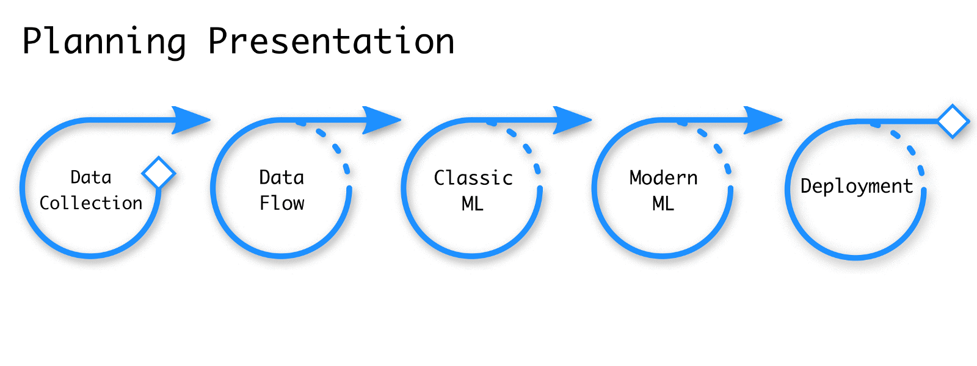
Machine Learning - Workflow

Slide 41
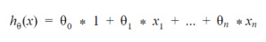
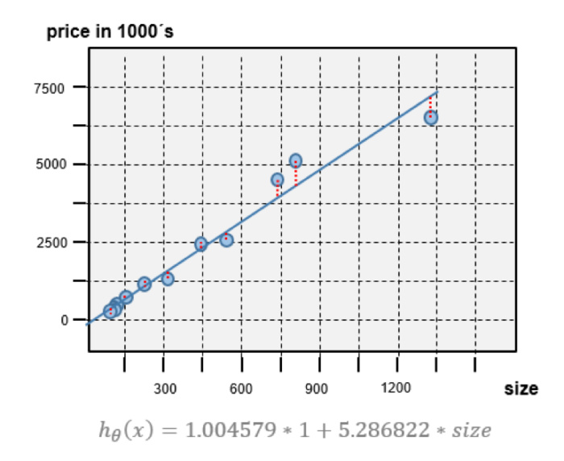
Machine Learning – Linear Regression
Linear Regression: one of the simplest supervised learning algorithms. This algorithm assumes that the relationship between input features and the outputted label is linear (i.e. x1, x2…xn is adding to each other)
Objective function: minimize the error (i.e. the distance between the calculated y value and the real y value). One way is to calculate the squared error

Slide 42

Machine Learning - Decision Tree
Go from observations about an item (represented in the branches) to conclusions about the item's target value (represented in the leaves).
Tree models where the target variable can take a discrete set of values are called classification trees; in these tree structures, leaves represent class labels and branches represent conjunctions of features that lead to those class labels. Decision trees where the target variable can take continuous values (typically real numbers) are called regression trees.
(Notes: Automatic Rule-based
High Bias -> Random Forest)

Slide 43

Machine Learning - SVM
Support Vector Machine (SVM): a discriminative classifier formally defined by a separating hyperplane.
The goal is to find the hyperplane that gives the largest minimum distance to the training examples. Therefore, the optimal separating hyperplane maximizes the margin of the training data (those data points in solid color that formed the maximum margin are the support vectors)

Slide 44

Machine Learning - SVM
Nonlinear classification performed by applying kernel transformation
Transform to higher dimension space
https://www.youtube.com/watch?v=3liCbRZPrZA
(Notes: Statistical significance, Curse of Dimensionality)

Slide 45
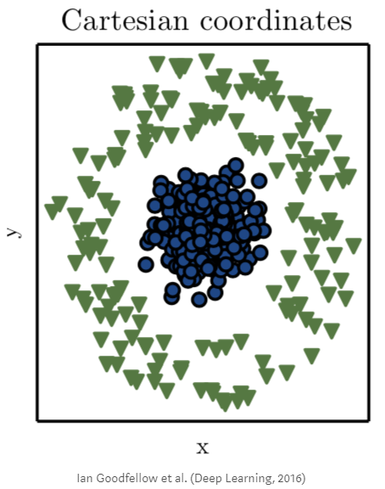
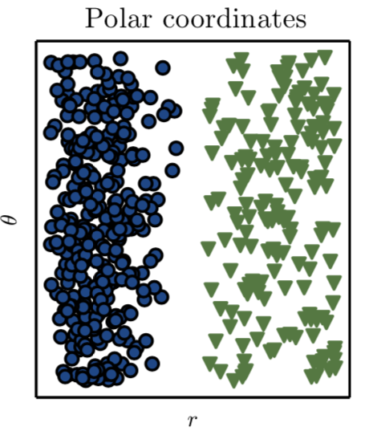
Machine Learning - SVM
Nonlinear classification performed by applying kernel transformation
Transform to another co-ordinate space

Slide 46
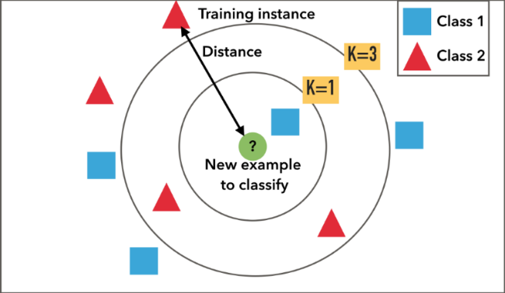
Machine Learning - kNN
The k-Nearest-Neighbors (kNN) algorithm uses a very simple approach to perform classification. When tested with a new example, it looks through the training data and finds the k training examples that are closest to the new example.

Slide 47
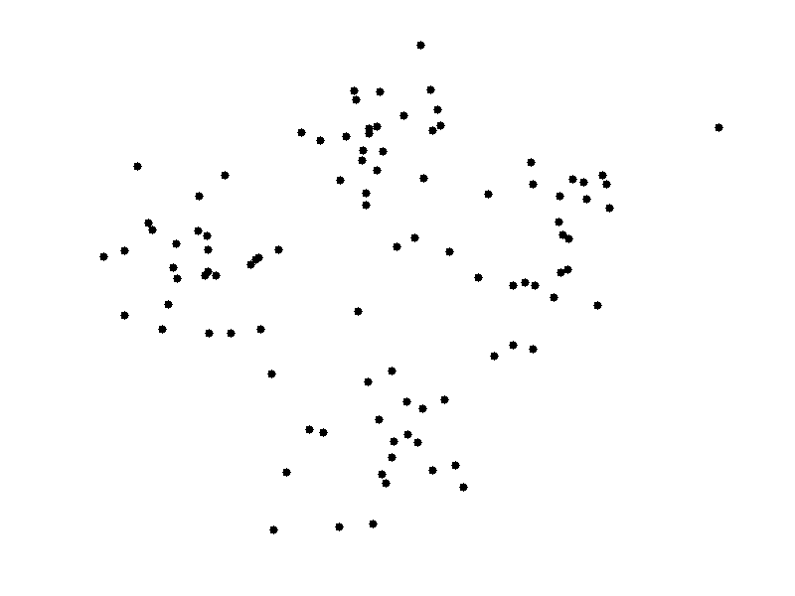
Machine Learning – k-Means Clustering
k-means clustering: a type of unsupervised learning (unlabeled data).Find k groups in the data. The algorithm works iteratively to assign each data point to one of k groups based on the features that are provided. Data points are clustered based on feature similarity.
The centroids of the k clusters, which can be used to label new data
Labels for the training data (each data point is assigned to a single cluster)
Example: https://towardsdatascience.com/using-unsupervised-learning-to-plan-a-paris-vacation-geo-location-clustering-d0337b4210de

Slide 48
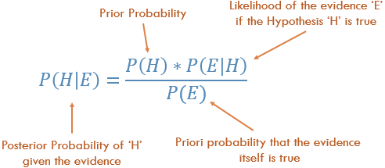
Machine Learning - Naive Bayes
Naive Bayes: is a simple probabilistic classifier which is based on Bayes theorem with strong and naïve independence assumptions (for example each spam email is independent of each other).
(Note: Frequentist vs Bayesian) – Objective vs Subjective view of chance

Slide 49
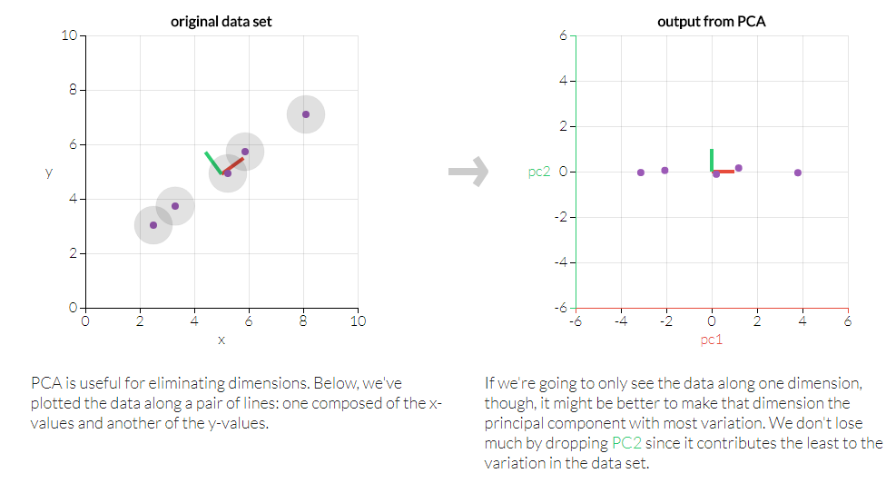
Machine Learning - PCA
Principle Component Analysis: dimension reduction technique used to emphasize variation and bring out strong patterns in a dataset
http://setosa.io/ev/principal-component-analysis/
(Example: Probably don’t need both HSI and tracker fund px to model market sentiment)

Slide 50
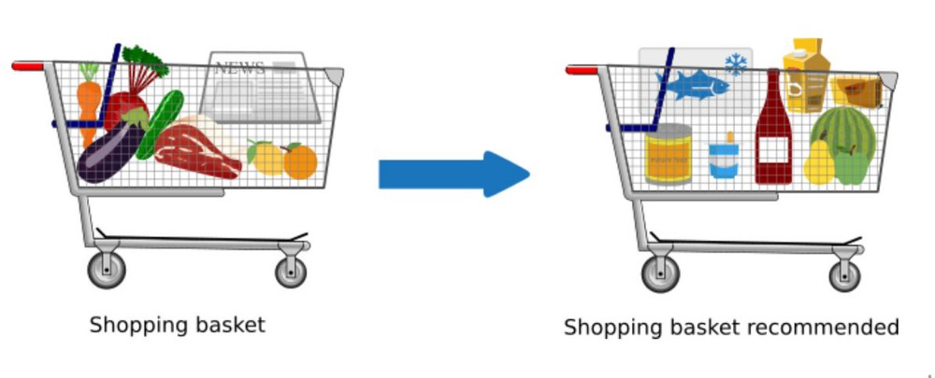
Machine Learning – Market Basket
Market Basket: identifies the strength of association between pairs of products purchased together and identify patterns of co-occurrence.
(Supermarket Diaper & Beer Story: https://blog.patternbuilders.com/2011/03/02/tales-of-beers-and-diapers/ )
Apriori: https://www.youtube.com/watch?v=TcUlzuQ27iQ
FP-Growth: https://www.youtube.com/watch?v=vPcJEFFWN_k&t=18s

Slide 51
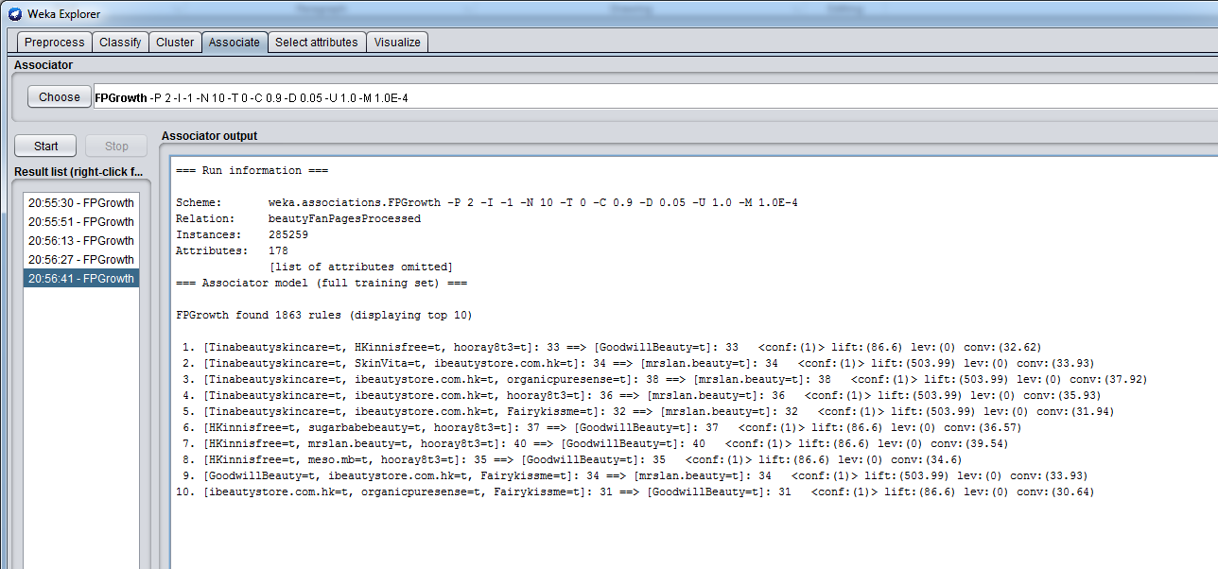
Machine Learning – Market Basket
Weka Example

Slide 52
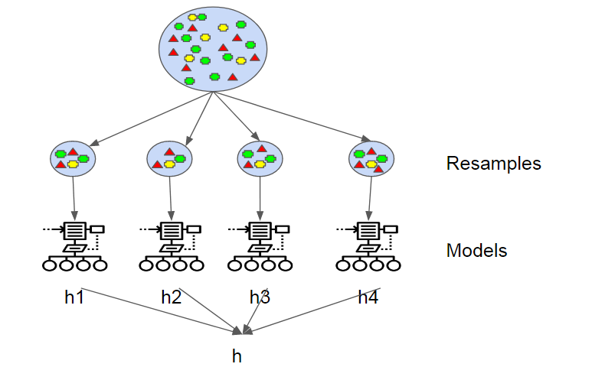
Machine Learning – Ensemble
Bootstrap Aggregating (Bagging): ensemble meta-algorithm designed to improve the stability and accuracy in statistical classification and regression. It also reduces variance and helps to avoid overfitting. It can be used with many type of the methods and is a special case of the model averaging approach.

Slide 53
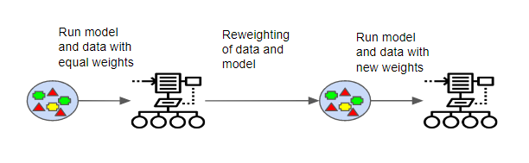
Machine Learning – Ensemble
AdaBoost (Adaptive Boosting): is a meta-algorithm and can be used in conjunction with many other learning algorithms to improve their performance. The output of the other learning algorithms ('weak learners') is combined into a weighted sum that represents the final output of the boosted classifier. AdaBoost is adaptive in the sense that subsequent weak learners are tweaked in favor of those instances misclassified by previous classifiers.
三個臭皮匠，勝過一個諸葛亮 (3 idiots are better than one smart guy) ?

Slide 54
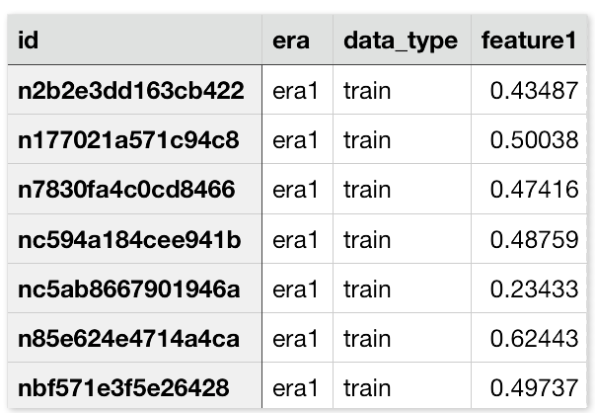
Machine Learning – Ensemble
Another way to think about ensemble learning is the fable of the blind men and the elephant. Where each blind man found a feature of the elephant and they all thought it was something different
Example: https://numer.ai/learn
No data scientist has a machine learning model that is better than all the others
Not a search for the ‘best’ model; it is a platform to synthesize many different models with many different characteristics
Collaboration to build the meta model
Reward with cryptocurrency

Slide 55
Open Discussion on AI
https://theoutline.com/post/2373/is-artificial-intelligence-going-off-the-rails
AI vs IA (Intelligence Augmentation): assist humans rather than replace them
Everybody knows that my brain does not operate by having trillions of examples. The mechanisms that work for AI practically today aren’t mirrors of what goes on in the brain.
More on the “clickbait” end of the public discussion about AI.
The symbolic systems program at Stanford [in which computer science students take classes in philosophy, linguistics and other non-STEM disciplines] is a good way to get broader thinking involved in tech.
(Side bar: HK students are over-fit, Parents needs PCA for their children)

Slide 56
Open Discussion on AI
One quote saying that “All models are wrong but some are useful”. Do you trust AI? (Weather forecast example)
Is AI going to replace or help the people?
What’s the social Impact on AI?
How much you worry about the privacy? (Social Media, Instant messaging, Wi-Fi-hotspots, Telecom companies, Electronic Payment records etc.)
http://www.wired.co.uk/article/chinese-government-social-credit-score-privacy-invasion

Slide 57

Machine Learning – Over fit / Under fit
Under fit: cannot capture the underlying trend of the data
Over fit: instead of making reliable predictions on unseen test data, it describes random error or noise. It model the underlying relationship excessively complex (too many parameters relative to the observations).The result is poor predictive performance, as it overreacts to minor fluctuations in the training data
(The key different from optimization is that Machine Learning needs to generalize the solution to predict unseen data)

Slide 58
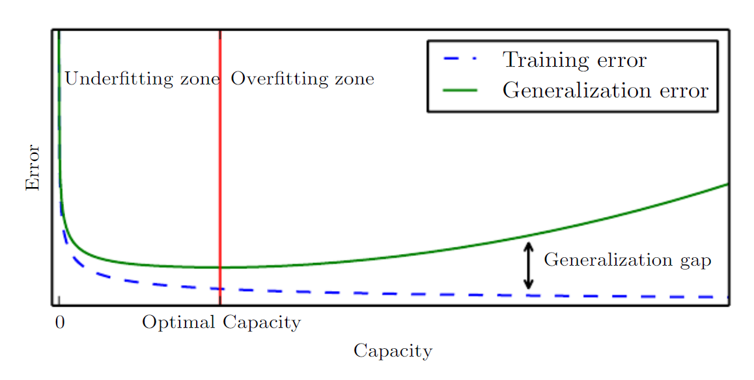
Machine Learning – Model Capacity
Model Capacity: its ability to fit a wide variety of functions. Models with low capacity may struggle to fit the training set. Models with high capacity can over fit by memorizing properties of the training set that do not serve them well on the test set.

Slide 59
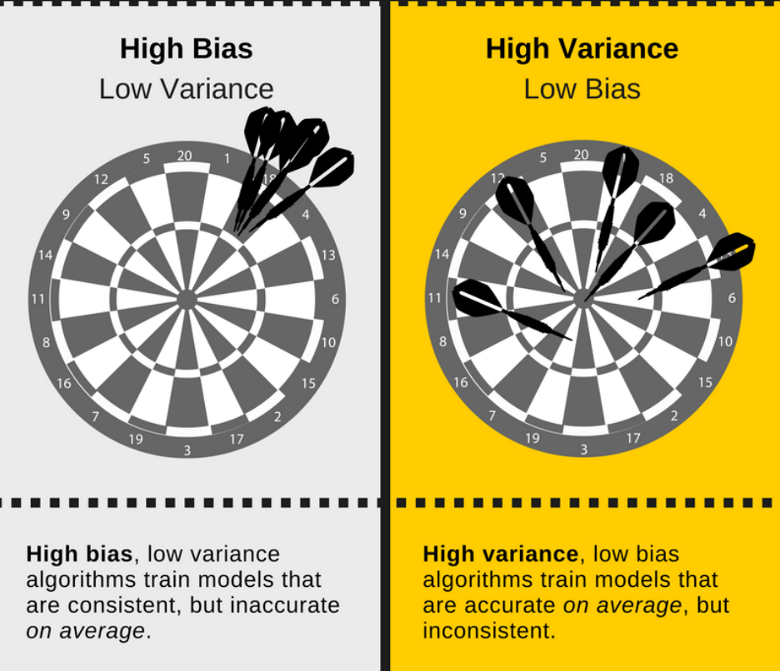
Machine Learning – Bias-Variance Tradeoff
Bias: when model has limited flexibility to learn the true relationship from dataset
Variance: when model is sensitive to specific sets of training data

Slide 60
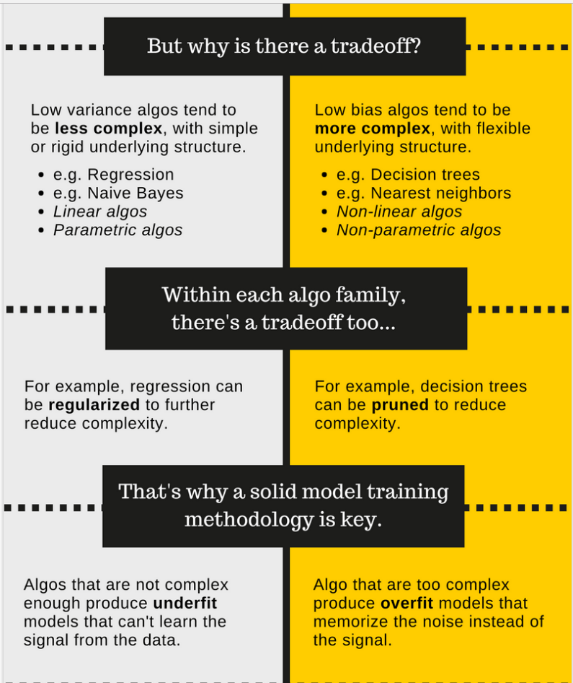
Machine Learning – Bias-Variance Tradeoff
To get good prediction, need to find a balance of Bias and Variance that minimizes total error.
Hence, it usually requires iteratively process to try different models and tune the hyper-parameters

Slide 61
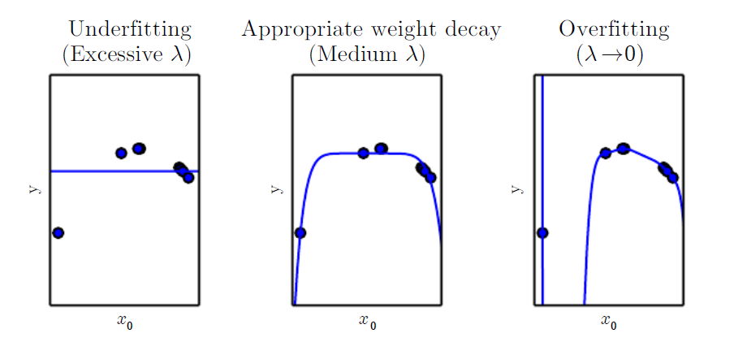
Machine Learning – Regularization
Regularization: introducing additional information in order to prevent overfitting (any component in the cost function that penalizes the complexity of the model). For example: give a learning algorithm a preference for one solution
Early stopping: can be viewed as regularization in time. Intuitively, a training procedure like gradient descent will tend to learn more and more complex functions as the number of iterations increases. By regularizing on time, the complexity of the model can be controlled, improving generalization.

Slide 62
Machine Learning – Thoughts
Important to pick the right features (data set) and which generally requires domain knowledge and feature engineering. (Garbage-in Garbage-out)
(Priority Email example – use transaction data over the content)
Understand the properties of the data and find the appropriate Machine Learning model.
For example, distance-base data (like crime hotspots), kNN can be a good starting points
Beware of over-fit in the training data
Beware class imbalance (especially in anomaly detection) and purely looking at accuracy number is not enough

Slide 63
Data Analysis – Historical Tick Data
https://www.hkex.com.hk/eng/ods/historicalData.aspx
Historical Full Book - Securities Market (CSV Format) provides information on every order and trade of Main Board and GEM stocks in CSV format. File is available on a daily basis, normally at around 10:00pm.
$5,000/Month
Historical Order Book and Statistics Update - Securities Market provides intra-day order book and statistics information recorded on the HKEX's Main Board and GEM stocks in CSV format. File is available on a daily basis, normally at around 10:00pm.
$2,500/Month

Slide 64
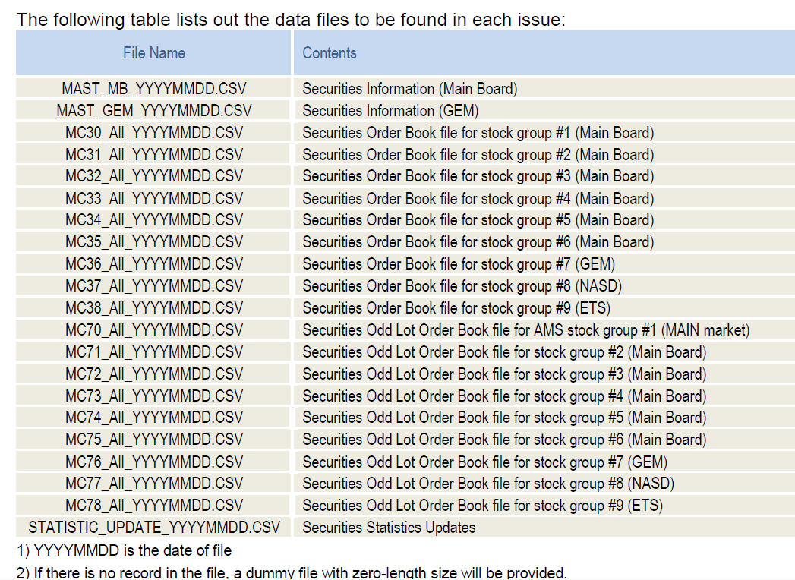
Data Analysis – Historical Tick Data

Slide 65
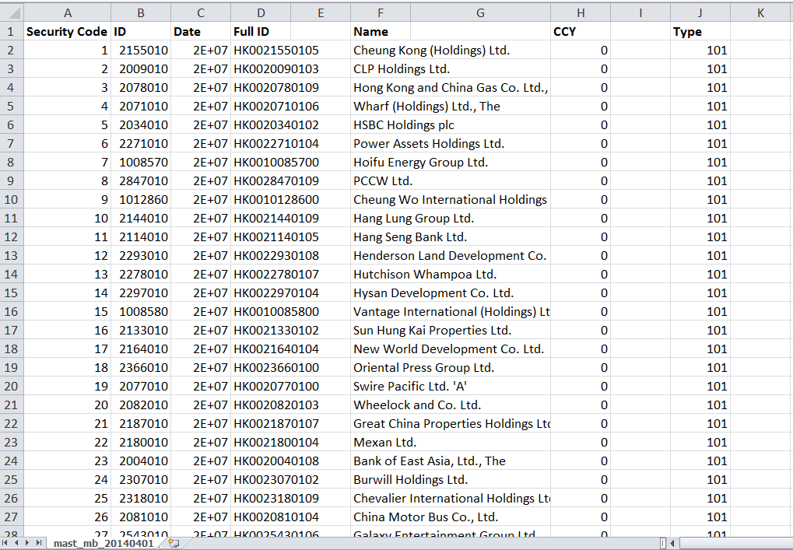
Data Analysis – Historical Tick Data

Slide 66
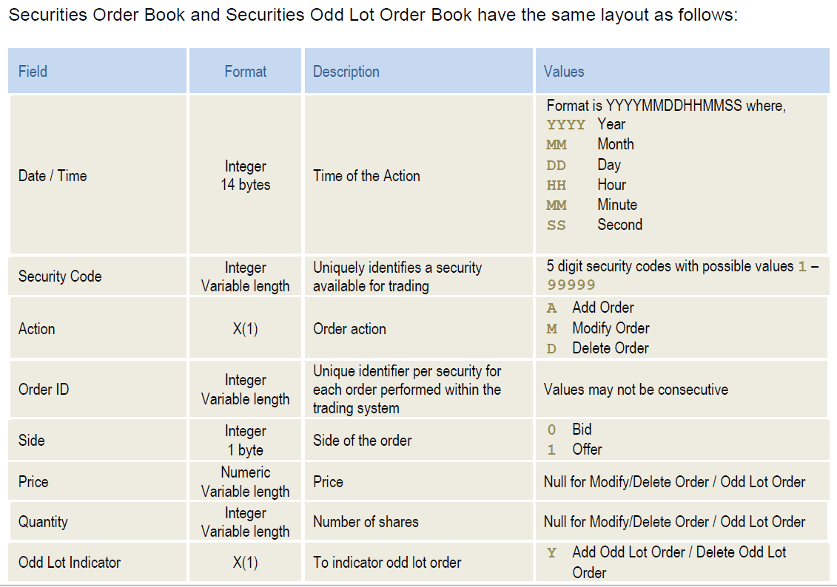
Data Analysis – Historical Tick Data

Slide 67
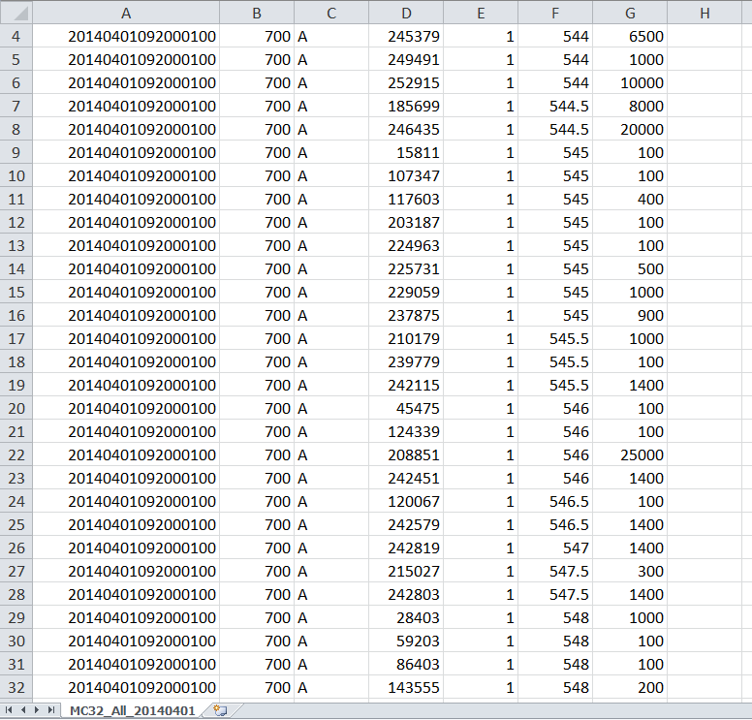
Data Analysis – Historical Tick Data

Slide 68
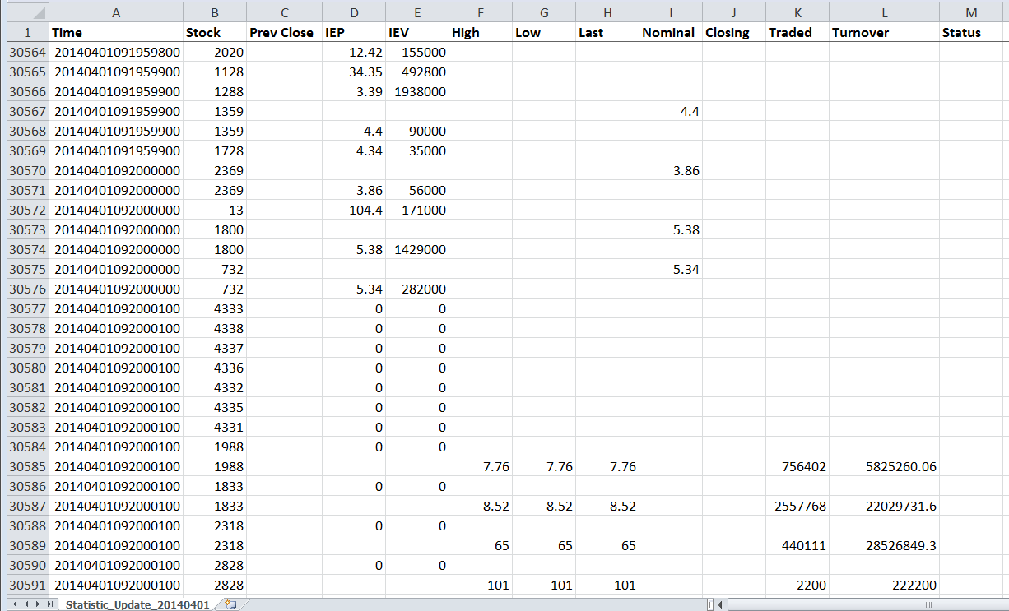
Data Analysis – Historical Tick Data

Slide 69
Case Study: Short Term Price Movement
Order Book Imbalance: the average ratio between the best bid and best ask size over a 1-min window. If the average bid size is larger than the ask size (hence a positive ratio), like the example below, it indicates the price is more likely to go up. Vice versa, the price is more likely to go down.
1min-Order Book-Imbalance = Avg (Log(Best BidSize/ Best AskSize))
Options: We can take into account the first few levels (for example 3 levels) of the order book while the top level of the book will have higher weighting. The 1-min duration can also be customized to a shorter or longer duration.
Size | Bid | Ask | Size
1,000,000 | 9.5 | 9.6 | 20,000
500,000 | 9.4 | 9.7 | 50,000
700,000 | 9.3 | 9.8 | 80,000
Notes:
Ask why taking log – because the asymmetry of +ve and –ve ratio

Slide 70
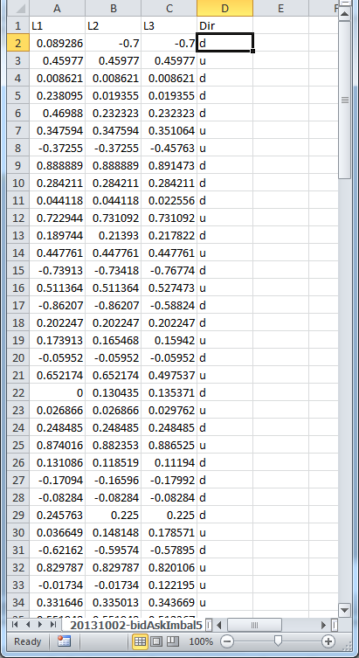
Case Study: Short Term Price Movement
Use Decision Tree to predict short-term stock (5.HK) movement (go up or down) from Order Book Imbalance (OBI) data.
L1: Level-1 OBI
L2: Level-2 OBI
L3: Level-3 OBI
Dir: Direction - u(up) , d (down)

Slide 71
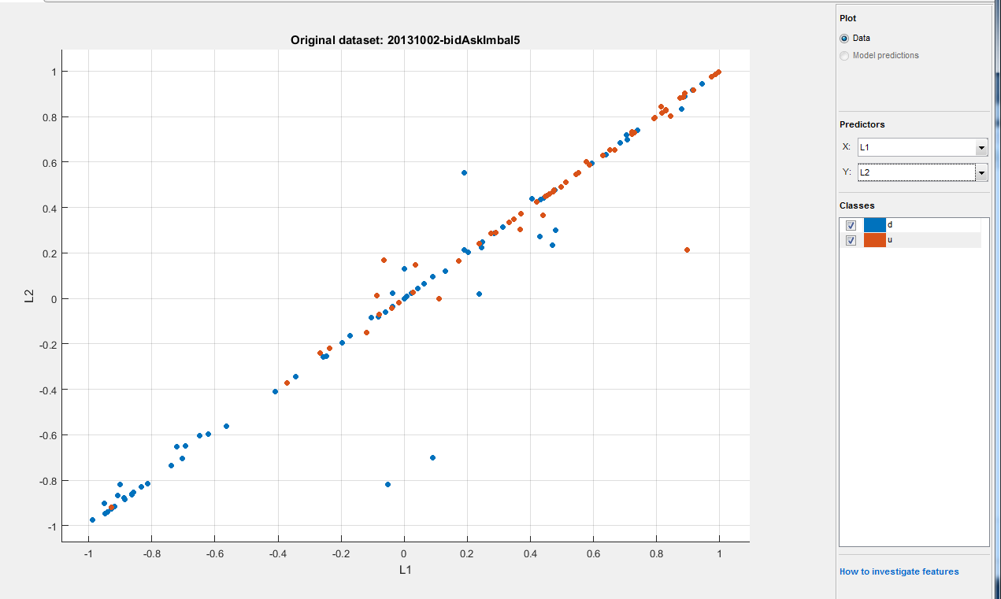
Case Study: Short Term Price Movement
Visualize the data: plotting Level-1 OBI and Level-2 OBI
Brown dots: stock going up, Blue dots: stock going down
More Brown dots (up) when both Level-1 OBI and Level-2 OBI are positive and vice versa

Slide 72
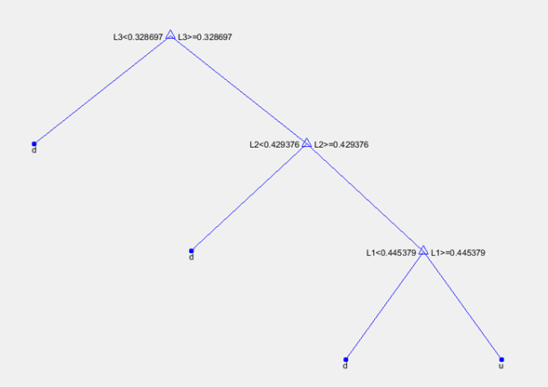
Case Study: Short Term Price Movement
Decision Tree training results for this Stock to be more likely to go up when:
Level-1 OBI > 0.445379 and Level-2 OBI > 0.429376 and Level-3 OBI > 0.328697

Slide 73
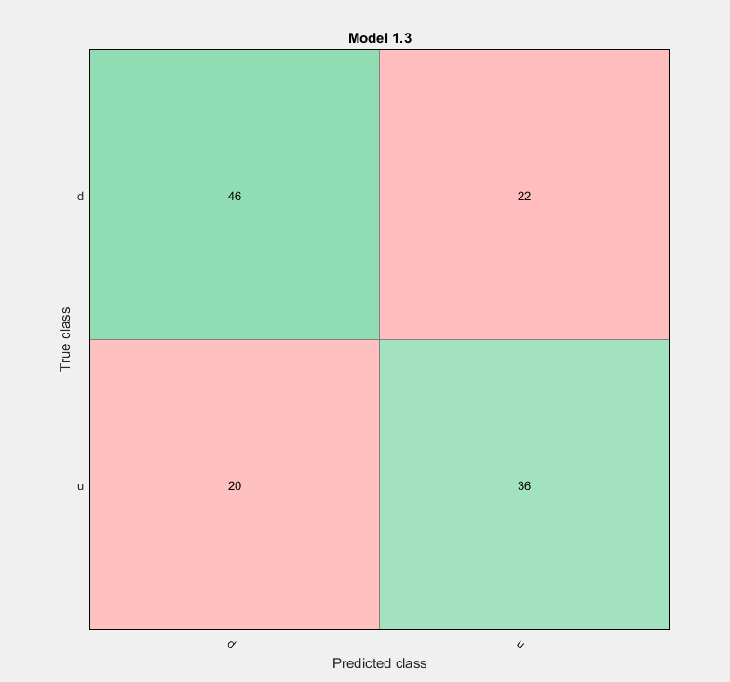
Case Study: Short Term Price Movement
Test Data Performance
Total : 46 + 22 + 20 + 36 = 124
Predicted Correctly: 46 + 36 = 82
Accuracy: 82/124 = 66.1% (Any Improvement suggestions?)

Slide 74
Machine Learning – Tools & API
Java
Weka: https://www.cs.waikato.ac.nz/ml/weka/
Apache Mahout: http://mahout.apache.org/
Apache Spark MLlib: https://spark.apache.org/mllib/
MALLET: http://mallet.cs.umass.edu/
Python
scikit-learn: http://scikit-learn.org/
(Note: Neural Network and Deep Learning related libraries are not included here)

Slide 75
Further Reading
Hands-on machine learning with scikit-learn and tensorflow: http://shop.oreilly.com/product/0636920052289.do
Why is machine learning in finance so hard: https://www.hardikp.com/2018/02/11/why-is-machine-learning-in-finance-so-hard/
https://github.com/sunggeunkim/Machine-Learning-Trading
Interpretable Machine Learning: https://christophm.github.io/interpretable-ml-book/

Slide 76

Thank you

